Slide 2
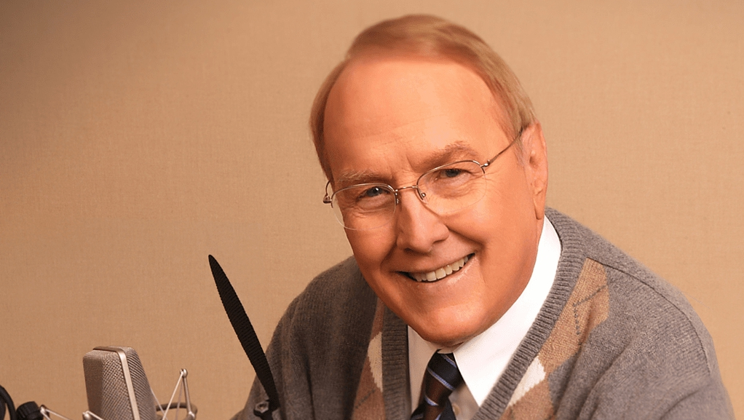

Slide 3
For the Lord is good,
and his faithful love endures forever; his faithfulness, through all generations.
Psalm 100:5 CSB

Slide 4
Why is a right understanding of God’s goodness important?
It impacts our
faith regarding
God’s willingness to really be with us in times of trouble…
and answer our
prayers.
It impacts our perception of how God views us – with love and acceptance or condemnation.
It impacts how
we will represent him to others, consciously or unconsciously.

Slide 5
While it is true that, in the Old Testament, we find
God, forced by the actions of humanity, pouring out
judgment, and we also read in the New Testament
that one day Jesus himself will inflict “vengeance on
those who do not know God and on those who do
not obey the gospel,” to quote Andrew Wommack,
“God’s nature is not judgment.”

Slide 6
Moses said, “Please show me your glory.”
¹⁹ And he said, “I will make all my goodness pass before you and will proclaim before you my name ‘The Lord.’”
Exodus 33:18-19a CSB

Slide 7
Exodus 34:5-6 CSB
The Lord came down in a cloud, stood with him
there, and proclaimed his name, “the Lord.”
⁶ The Lord passed in front of him and proclaimed:
The Lord—the Lord is a compassionate
and gracious God, slow to anger and abounding in faithful love and truth….

Slide 8
The Lord—the Lord is a compassionate
and gracious God, slow to anger and
abounding in faithful love and truth….
Exodus 34:6b CSB

Slide 9
Then Joseph
hurried out, for
his compassion grew warm for his brother, and he sought
a place to weep.
Genesis 43:30a ESV
It moved him
deeply to see his brother. So Joseph hurried out and looked for a
place to cry.
NIRV
…his heart was
deeply touched over his brother, and he sought privacy
to weep….
AMP

Slide 10
The Lord—the Lord is a compassionate
and gracious God, slow to anger and
abounding in faithful love and truth….
Exodus 34:6b CSB
chanuwn
combines the ideas of favor, compassion and generosity

Slide 12
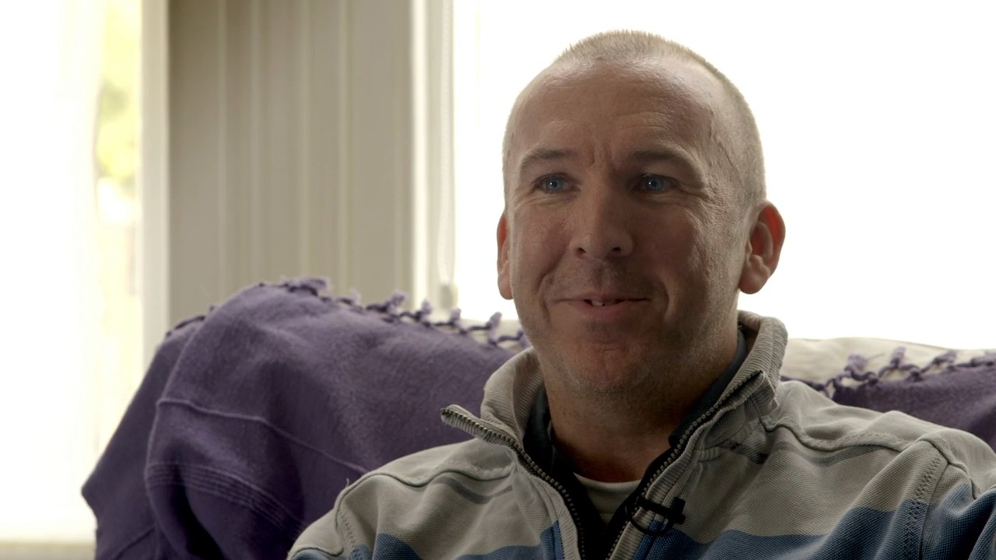
“He was the most generous sort of person.
If you ask for something, you got three of them.”
Adam Desmond

Slide 13
The Lord—the Lord is a compassionate
and gracious God, slow to anger and
abounding in faithful love and truth….
Exodus 34:6b CSB
an idiom meaning
‘long suffering’ or ‘slow to anger’

Slide 14
The longsuffering
of the Lord is part of his plan to save men from the punishment of sin.
2 Peter 3:15 paraphrase

Slide 15
“Any understanding
of the word that fails to suggest all three inevitably loses some of its richness.”
Vine’s OT Dictionary
The Lord—the Lord is a compassionate
and gracious God, slow to anger and
abounding in faithful love and truth….
Exodus 34:6b CSB
checed
combines the ideas of strength, steadfastness,
and love

Slide 16
The Lord—the Lord is a compassionate
and gracious God, slow to anger and
abounding in faithful love and truth….
Exodus 34:6b CSB
strong, steadfast love

Slide 17
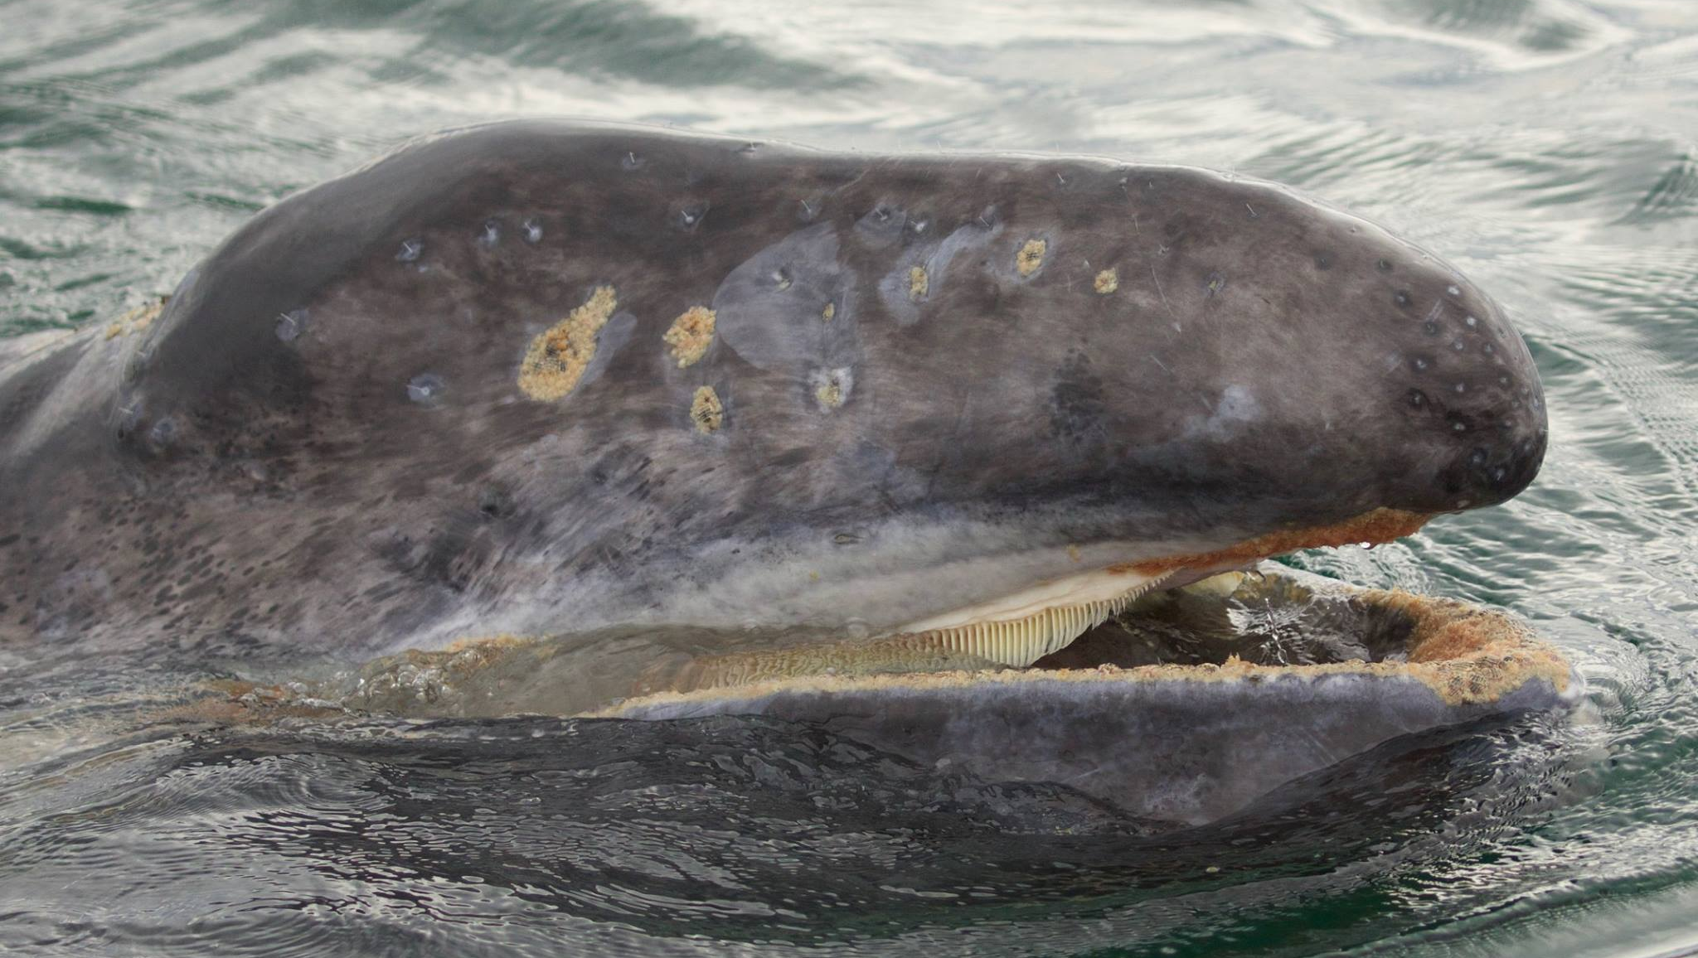
He prayed to the Lord: “Please, Lord, isn’t this what I thought while I was still in my own country? That’s why I fled toward Tarshish in the first place. I knew that you are a gracious and compassionate God, slow to anger, abounding in faithful love, and one who relents from sending disaster.”
Jonah 4:2 CSB

Slide 18
“And should not I
pity Nineveh, that great
city, in which there are
more than 120,000 persons who do not know their
right hand from their left, and also much cattle.”
Jonah 3:11 ESV

Slide 19
The Lord—the Lord is a compassionate
and gracious God, slow to anger and
abounding in faithful love and truth….
Exodus 34:6b CSB
emet
“The basic root idea is firmness or certainty.”

Slide 20
The Lord—the Lord is a compassionate
and gracious God, slow to anger and
abounding in faithful love and truth….
Exodus 34:6b CSB
sureness
reliability
stability
faithfulness
truth

Slide 21
Why ‘truth’ instead of ‘faithfulness’?
This verse,
in the Septuagint,
is translated using alethinos, which means true, in the sense of being real
or certain.
And we know that
the Son of God has come
and has given us understanding, so that we may know him who
is true; and we are in him who
is true, in his Son Jesus Christ. He is the true God and
eternal life.
1 John 5:20 ESV

Slide 22
Why ‘truth’ instead of ‘faithfulness’?
This verse,
in the Septuagint,
is translated using alethinos, which means true, in the sense of being real
or certain.
62% of major
English translations, including CSB, NASB, KJV, NKJV, YLT and Darby, translate emet with truth in
Exodus 34:6.
It is consistent
with what is said of
Jesus, who is himself
the clearest and most definitive revelation
of God’s nature.

Slide 23
The Word became
flesh and dwelt among us. We observed his glory, the glory as the one and only Son from the Father, full of
grace and truth.
John 1:14 CSB
always
merciful to
the sinner but never glossing over sin

Slide 24
The Lord—the Lord is a compassionate
and gracious God, slow to anger and
abounding in faithful love and truth….
Exodus 34:6b CSB

Slide 25
The Lord—the Lord is
a compassionate and gracious God,
incredibly longsuffering,
abounding in strong, steadfast love
and unwavering truth.

Slide 26
For the Lord is good,
and his faithful love endures forever; his faithfulness, through all generations.
Psalm 100:5 CSB

